Slide 1

Entrepreneurship: Successfully Launching New Ventures
Sixth Edition
Chapter 6
Writing a Business Plan
Notes:
If this PowerPoint presentation contains mathematical equations, you may need to check that your computer has the following installed:
1) MathType Plugin
2) Math Player (free versions available)
3) NVDA Reader (free versions available)

Slide 2
Learning Objectives
6.1 Explain the purpose of a business plan.
6.2 Describe who reads a business plan and what they are looking for.
6.3 Discuss the guidelines to follow to write an effective business plan.
6.4 Identify and describe a suggested outline of a business plan.
6.5 Explain how to effectively present a business plan to potential investors.

Slide 3
What Is a Business Plan?
Business Plan
A business plan is a written narrative, typically 25 to 35 pages long, that describes what a new business intends to accomplish and how it intends to accomplish it.
Dual-Use Document
For most new ventures, the business plan is a dual-purpose document that is used both inside and outside the firm.

Slide 4
Who Reads the Business Plan—and What Are They Looking For?
There are two primary audiences for a firm’s business plan
Audience | What They are Looking For
A Firm’s Employees | A clearly written business plan helps the employees of a firm operate in sync and move forward in a consistent and purposeful manner.
Investors and other external stakeholders | A firm’s business plan must make the case that the firm is a good use of an investor’s funds or the attention of others.

Slide 5
Guidelines for Writing a Business Plan (1 of 5)
Structure of the Business Plan
To make the best impression, a business plan should follow a conventional structure, such as the outline for the business plan shown in the chapter.
Although some entrepreneurs want to demonstrate creativity, departing from the basic structure of the conventional business plan is usually a mistake.
Typically, investors are busy people and want a plan where they can easily find critical information.

Slide 6
Guidelines for Writing a Business Plan (2 of 5)
Software Packages
There are many software packages available that employ an interactive, menu-driven approach to assist in the writing of a business plan.
Some of these programs are very helpful. However, entrepreneurs should avoid a boilerplate plan that looks as though it came from a “canned” source.
Sense of Excitement
Along with facts and figures, a business plan needs to project a sense of anticipation and excitement about the possibilities that surround a new venture.

Slide 7
Guidelines for Writing a Business Plan (3 of 5)
Content of the Business Plan
The business plan should give clear and concise information on all the important aspects of the proposed venture.
It must be long enough to provide sufficient information yet short enough to maintain reader interest.
For most plans, 25 to 35 pages is sufficient.
Types of Business Plans
There are three types of business plans, which are shown on the next slide.

Slide 8
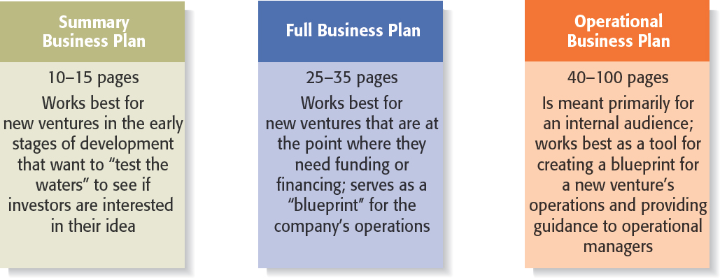
Guidelines for Writing a Business Plan (4 of 5)
Figure 6.2 Types of Business Plans

Slide 9
Guidelines for Writing a Business Plan (5 of 5)
Recognizing the Elements of the Plan May Change
It’s important to recognize that the plan will usually change while written.
New insights invariably emerge when an entrepreneur or a team of entrepreneurs immerse themselves in writing the plan and start getting feedback from others.

Slide 10
Outline of Business Plan
A suggested outline of a business plan is shown on the next several slides.
Most business plans do not include all the elements introduced in the sample plan; we include them here for the purpose of completeness.
Each entrepreneur must decide which elements to include in his or her plan.

Slide 11
Section 1: Executive Summary (1 of 2)
Executive Summary
The executive summary is a short overview of the entire business plan.
It provides a busy reader with everything that needs to be known about the new venture’s distinctive nature.
An executive summary shouldn’t exceed two single-spaced pages.
Even though the executive summary appears at the beginning of the business plan, it should be written last.
The plan itself will evolve as it’s written, so not everything is known at the outset.

Slide 12
Section 1: Executive Summary (2 of 2)
Key Insights
In many instances an investor will first ask for a copy of the firm’s PowerPoint deck or executive summary and will request of a copy of the full business plan only if the PowerPoint deck or executive summary is sufficiently convincing.
The executive summary, then, is arguably the most important section of a business plan.

Slide 13
Section 2: Industry Analysis (1 of 2)
Industry Analysis
This section should begin by describing the industry the business will enter in terms of its size, growth rate, and sales projections.
Items to include in this section:
Industry size, growth rate, and sales projections.
Industry structure.
Nature of participants.
Key success factors.
Industry trends.
Long-term prospects.

Slide 14
Section 2: Industry Analysis (2 of 2)
Key Insights
Before a business selects a target market it should have a good grasp of its industry—including where its promising areas are and where its points of vulnerability are.
The industry that a company participates in largely defines the playing field that a firm will participate in.

Slide 15
Section 3: Company Description (1 of 2)
Company Description
This section begins with a general description of the company.
Items to include in this section:
Company description.
Company history.
Mission statement.
Products and services.
Current status.
Legal status and ownership.
Key partnerships (if any).

Slide 16
Section 3: Company Description (2 of 2)
Key Insights
While at first glance this section may seem less important than the others, it is extremely important.
It demonstrates to your reader that you know how to translate an idea into a business.

Slide 17
Section 4: Market Analysis (1 of 2)
Market Analysis
The market analysis breaks the industry into segments and zeroes in on the specific segment (or target market) to which the firm will try to appeal.
Items to include in this section:
Market segmentation and target market selection.
Buyer behavior.
Competitor analysis.
Estimate of the firm’s annual sales and market share.

Slide 18
Section 4: Market Analysis (2 of 2)
Key Insights
Most start-ups do not service their entire industry. Instead, they focus on servicing a specific (target) market within the industry.
It’s important to include a section in the market analysis that deals with the behavior of the consumers in the market. The more a start-up knows about the consumers in its target market, the more it can tailor its products or services appropriately.

Slide 19
Section 5: The Economics of the Business (1 of 2)
The Economics of the Business
This section addresses the basic logic of how profits are earned in the business and how many units of a business’s profits must be sold for the business to “break even” and then start earning a profit.
Items to include in this section:
Revenue drivers and profit margins.
Fixed and variable costs.
Operating leverage and its implications.
Start-up costs.
Break-even chart and calculations.

Slide 20
Section 5: The Economics of the Business (2 of 2)
Key Insights
Two companies in the same industry may make profits in different ways. One may be a high-margin, low-volume business, while the other may be a low-margin, high-volume business. It’s important to check to make sure the approach you select is sound.
Computing a break-even analysis is an extremely useful exercise for any proposed or existing business.

Slide 21
Section 6: Marketing Plan (1 of 2)
Marketing Plan
The marketing plan focuses on how the business will market and sell its product or service.
Items to include in this section:
Overall marketing strategy.
Product, price, promotions, and distribution.
Sales process (or cycle).
Sales tactics.

Slide 22
Section 6: Marketing Plan (2 of 2)
Key Insights
The best way to describe a start-up’s marketing plan is to start by articulating its marketing strategy, positioning, and points of differentiation, and then talk about how these overall aspects of the plan will be supported by price, promotional mix, and distribution strategy.
It’s also important to discuss the company sales process.

Slide 23
Section 7: Product (or Service) Design and Development Plan (1 of 2)
Design and Development Plan
If you’re developing a completely new product or service, you need to include a section in your business plan that focuses on the status of your development efforts.
Items to include in this section:
Development status and tasks.
Challenges and risks.
Projected development costs.
Proprietary issues (patents, trademarks, copyrights, licenses, brand names).

Slide 24
Section 7: Product (or Service) Design and Development Plan (2 of 2)
Key Insights
Many seemingly promising start-ups never get off the ground because their product development efforts stall or the actual development of the product or service turns out to be more difficult than thought.
As a result, this is a very important section for businesses developing a completely new product or service.

Slide 25
Section 8: Operations Plan (1 of 2)
Operations Plan
Outlines how your business will be run and how your product or service will be produced.
A useful way to illustrate how your business will be run is to describe it in terms of “back stage” (unseen to the customer) and “front stage” (seen by the customer) activities.
Items to include in this section:
General approach to operations.
Business location.
Facilities and equipment.

Slide 26
Section 8: Operations Plan (2 of 2)
Key Insights
Your have to strike a careful balance between adequately describing this topic and providing too much detail.
As a result, it is best to keep this section short and crisp.

Slide 27
Section 9: Management Team and Company Structure (1 of 2)
Management Team and Company Structure
The management team of a new venture typically consists of the founder or founders and a handful of key management personnel.
Items to include in this section:
Management team.
Board of directors (if you have one).
Board of advisors (if you have one).
Company structure.

Slide 28
Section 9: Management Team and Company Structure (2 of 2)
Key Insights
This is a critical section of a business plan.
Many investors and others who read the business plan look first at the executive summary and then go directly to the management team section to assess the strength of the people starting the firm.

Slide 29
Section 10: Overall Schedule (1 of 2)
Overall Schedule
A schedule should be prepared that shows the major events required to launch the business.
The schedule should be in the format of milestones critical to the business’s success.
Examples of milestones:
Incorporating the venture.
Completion of prototypes.
Rental of facilities.
Obtaining critical financing.
Starting production.
Obtaining the first sale.

Slide 30
Section 10: Overall Schedule (2 of 2)
Key Insight
An effectively prepared and presented schedule can be extremely helpful in convincing potential investors that the management team is aware of what needs to take place to launch the venture and has a plan in place to get there.

Slide 31
Section 11: Financial Projections (1 of 2)
Financial Projections
The final section of a business plan presents a firm’s pro forma (or projected) financial projections.
Items to include in this section:
Sources and uses of funds statement.
Assumptions sheet.
Pro forma income statements.
Pro forma balance sheets.
Pro forma cash flows.
Ratio analysis.

Slide 32
Section 11: Financial Projections (2 of 2)
Key Insights
Having completed the earlier sections of the plan, it’s easy to see why the financial projections come last.
They take the plans you’ve developed and express them in financial terms.

Slide 33
Presenting the Business Plan to Investors (1 of 2)
The Oral Presentation
The first rule in making an oral presentation is to follow directions. If you’re told you have 20 minutes, don’t talk for more than the allotted time.
The presentation should be smooth and well-rehearsed.
The slides should be sharp and not cluttered.
Questions and Feedback to Expect from Investors
The smart entrepreneur has a good idea of the questions that will be asked, and will be prepared for those queries.

Slide 34
Presenting the Business Plan to Investors (2 of 2)
Twelve PowerPoint Slides to Include in an Investor Presentation
Title Slide
Problem
Solution
Opportunity and target market
Technology
Competition
Marketing and sales
Management team
Financial projections
Current status
Financing sought
Summary

Slide 35

Copyright

